Slide 1
Innovation Tournaments Using the Darwinator: A Slide Deck for the Moderator
This material is drawn from our book:
Innovation Tournaments: Creating and Selecting Exceptional Opportunities
by Christian Terwiesch and Karl Ulrich (published 2009 by Harvard Business Press)

Slide 2
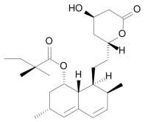
What is An Innovation? And What is an Innovation Tournament?
INNOVATION =
novel match of a solution and need that creates value
$
Needs
Solutions
Novelty in the Solution
Novelty in the matching
Novelty in the Need
Twitter
Value can be thought of as financial value or social value
At the outset, value generation is only a hypothesis: an opportunity is the seed of an innovation
Pictures from Wikipedia

Slide 3
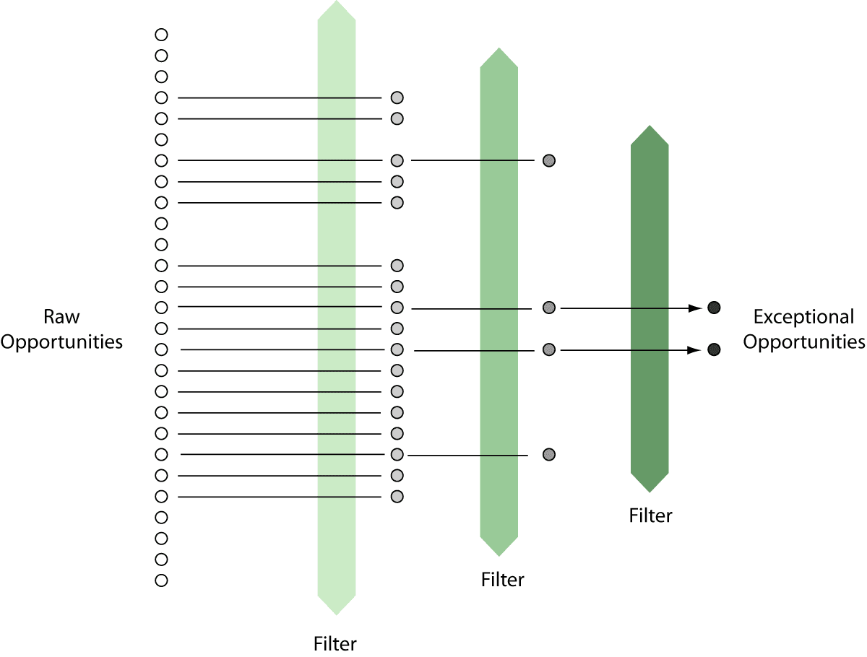
From Opportunities to Innovation
The Innovation Tournament Helps to Find the Exceptional Opportunities

Slide 4
Pay-offs Improve as Opportunity Moves Through Tournament
NPV
Concept Development
Prototype
Launch
realization
of value
one specific opportunity
expected value typically shifts
uncertainty typically narrows
0
Quality of opportunity
probability distribution of value to be realized from a specific opportunity
Distribution of universe of all opportunities
e.g., new products we can do as Paslode
e.g., “cordless framing nailer”

Slide 5
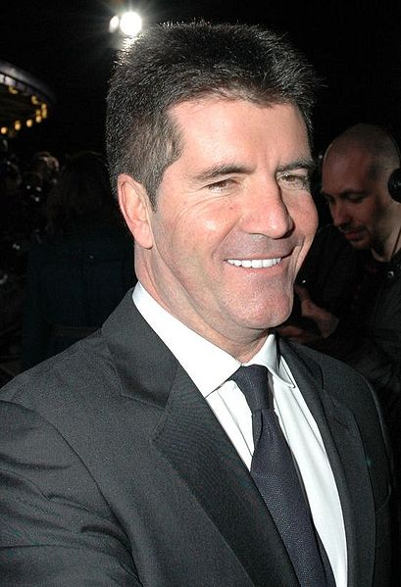
Innovation Tournaments: Just like a casting show
Pictures from Wikipedia

Slide 6
Innovation Tournaments

Slide 7
Objective of the Innovation Tournament Today
Insert company logo
Dear Team:
The events of the last year have created unprecedented opportunities for innovation at xxx.
In this context, I would like to create a set of new business opportunities for the xxxx market segment. I expect this sector to undergo some serious change in the future, reflecting changes in xxxx.
Of course, I understand that given the time you have for this effort, these opportunities will be quite preliminary. Nevertheless, I think this quick exploratory activity will be useful in stimulating discussion about whether and how we might address emerging market needs in this area.
I’d like you to take part of the day on xxxx, to develop about two dozen interesting opportunities, with the best handful identified based on the consensus of the group.
I would prefer that each opportunity be articulated in terms of
(a) the stakeholder targeted,
(b) the unmet need addressed, and
(c) one or more potential solution concepts. I do want to emphasize that I think of solutions in broader terms than our current product line. You might want to also (though not exclusively) consider solutions that involve service offerings or new business models.
Good luck and I look forward to hearing from you no later than next week.
xxxx Chief Executive Officer
Legal disclaimer: xxx never wrote this letter

Slide 8
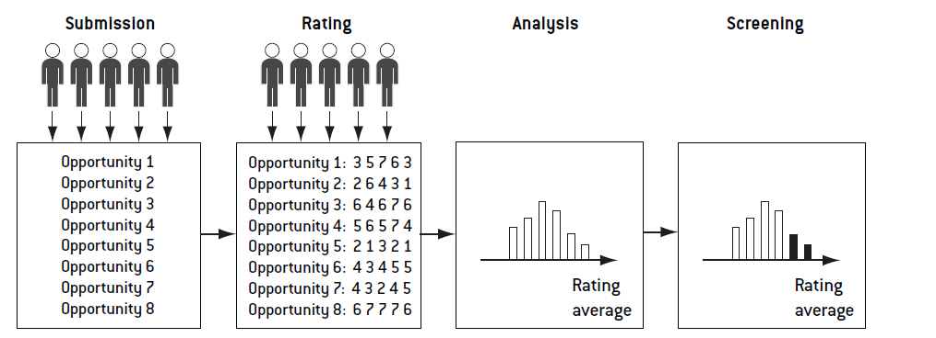
Voting Based Evaluation

Slide 9
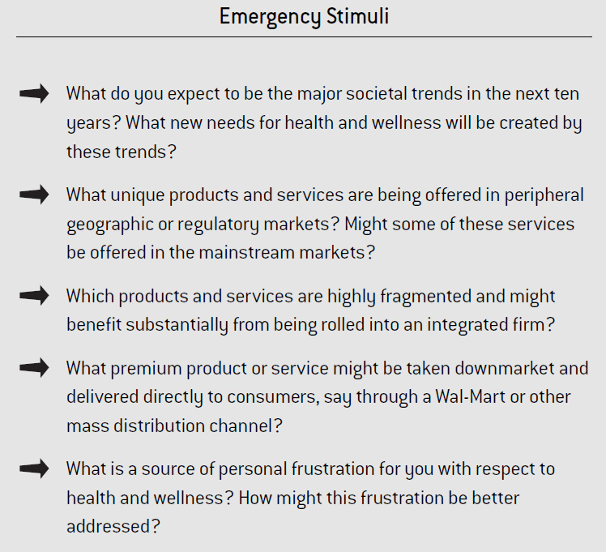
Should You Get Stuck…

Slide 10
Break-out Group Assignment
Your task is to develop a set of opportunities that have the potential to lead to a significant growth for your company and preferably meet the target outlined in the letter of your CEO.
Part I: Spend 15 minutes individually outlining a set of five (+/-) opportunities.
Then, spend 5 minutes entering the ideas into the Darwinator
Part II:
Spend 30 minutes in teams of brainstorming about additional opportunities (create new ones, combine existing ones). Then, spend 5 minutes entering them into the Darwinator
Part III:
Evaluate individually using the Darwinator

Slide 11
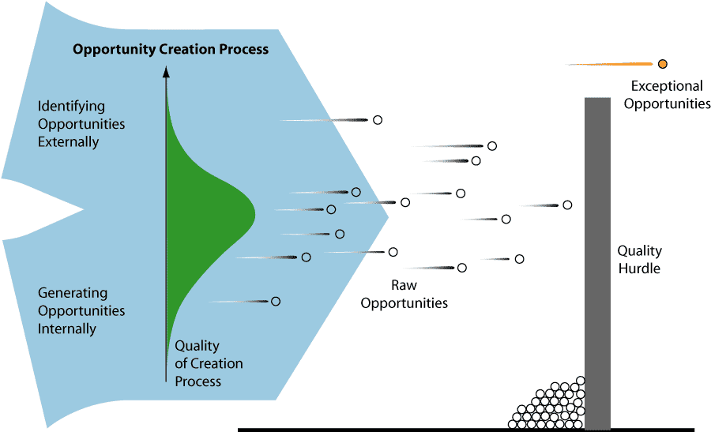

Slide 12
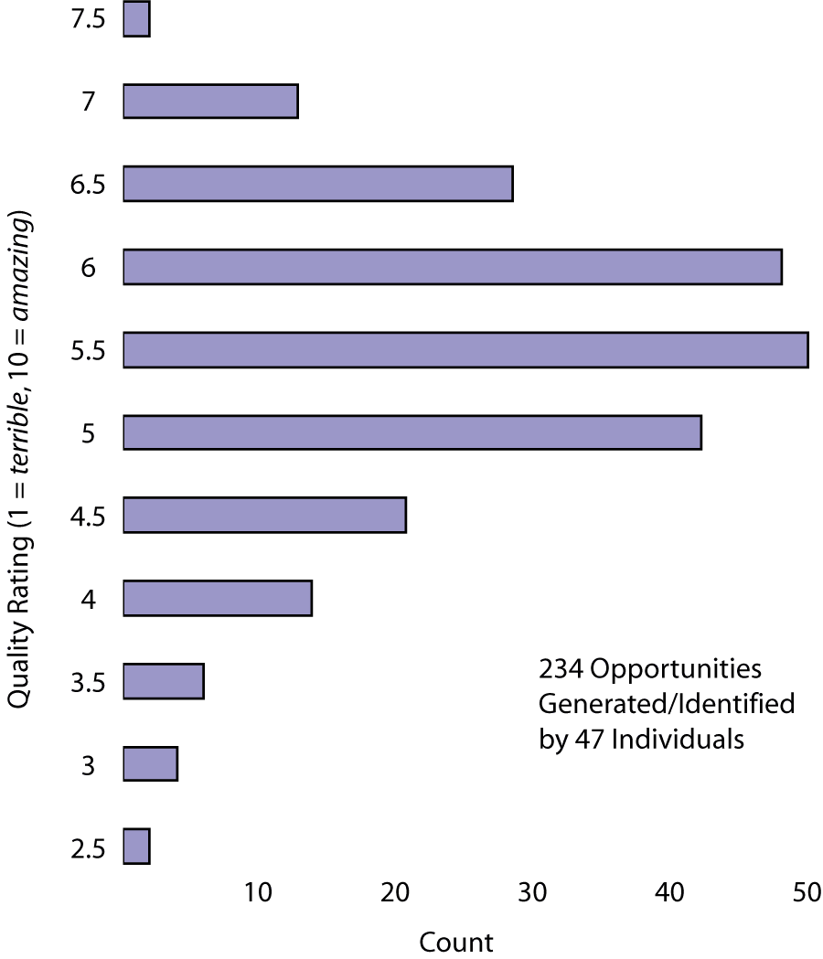
Brokering “Medical Tourism” for semi-elective surgery
Revenge Social Networking

Slide 13
Four Levers on Tournament Performance
3
Increase the accuracy in evaluating opportunities.
4
Increase the variance in the quality of opportunities generated.
Shift the mean quality of the opportunities generated.
2
1
Increase the number of opportunities generated.
“take more draws”

